Slide 1
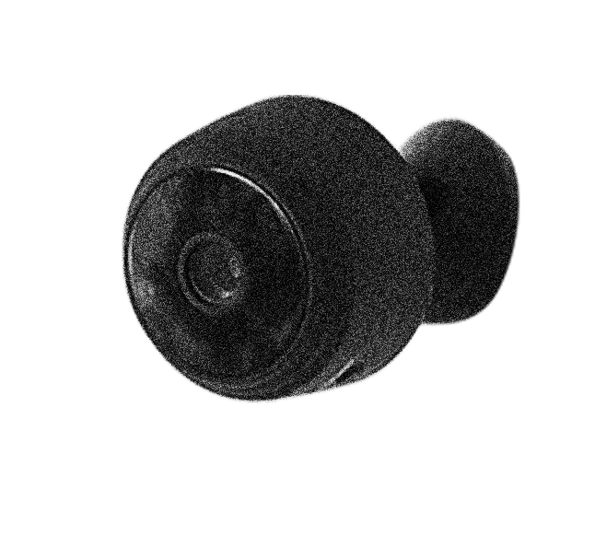

INTELIGENCIA ARTIFICIAL
Alexis y compañia
DATA PROTECTION AWARENESS TRAINING

Slide 2
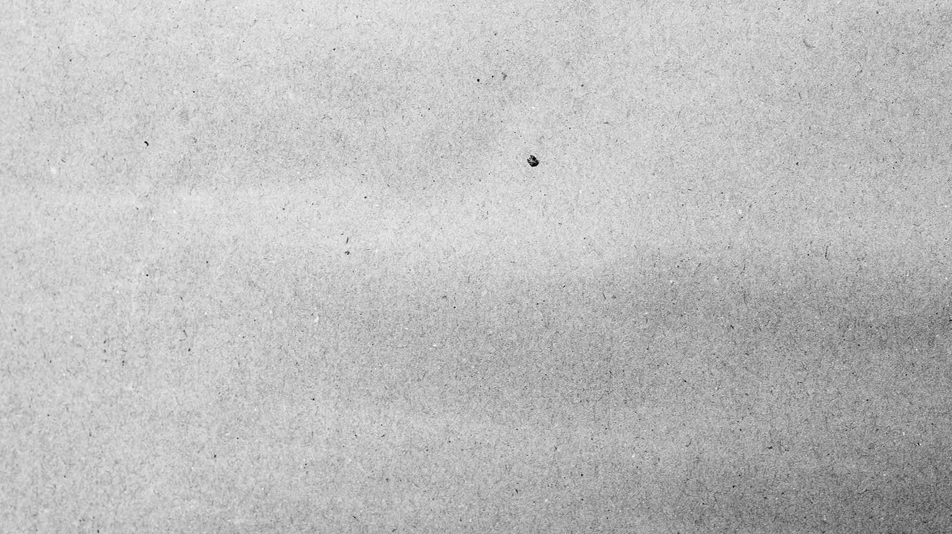
TABLA DE CONTENIDO
01
03
02
04
¿QUE ES?
APLICACIONES DE LA IA
En que consiste la Inteligencia Artificial
En que ambitos se usa la IA
TIPOS
EJEMPLOS
Cuales son las diferentes Inteligencias que existen
Algunos ejemplos actuales.

Slide 3
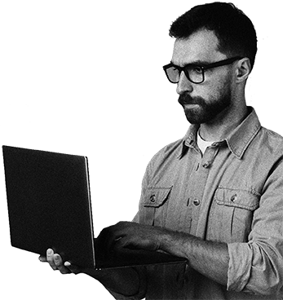
01
¿ QUE ES ?

Slide 4
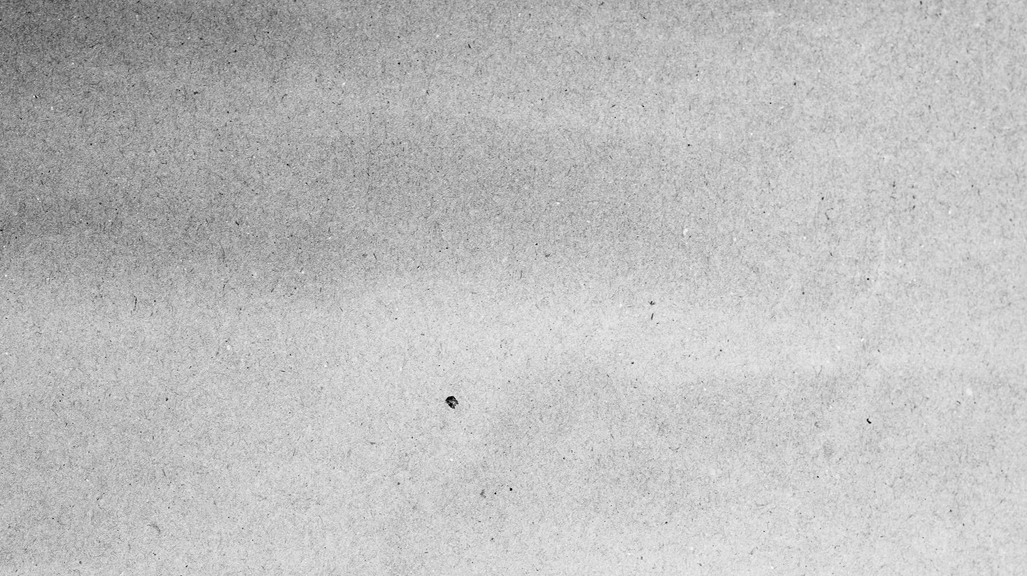
Que es ?
La Inteligencia Artificial (IA) es la combinación de algoritmos planteados con el propósito de crear máquinas que presenten las mismas capacidades que el ser humano. Una tecnología que todavía nos resulta lejana y misteriosa, pero que desde hace unos años está presente en nuestro día a día a todas horas.

Slide 5
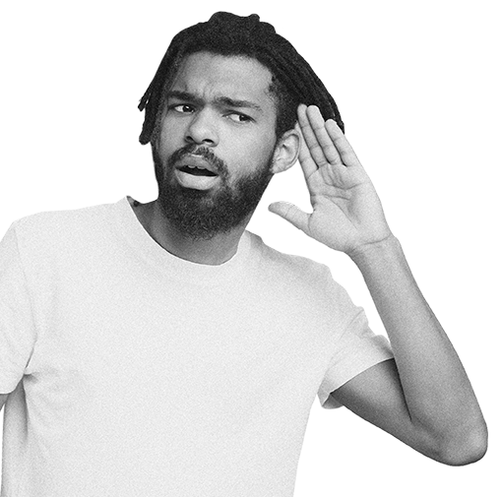
¿Como funciona?
La inteligencia artificial se desarrolla a partir de algoritmos , que son capacidades matemáticas de aprendizaje, y de los datos que hacen falta para entrenar los algoritmos. Los datos normalmente son datos observables, datos disponibles públicamente o datos generados en algunas empresas. Y los algoritmos iteran sobre esos datos para aprender a partir de ellos.
DATA PROTECTION AWARENESS TRAINING

Slide 6
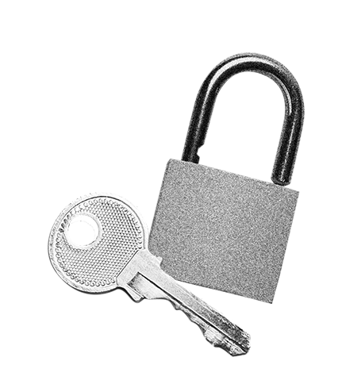
TIPOS!

Slide 7
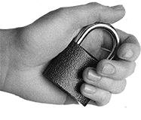
DIFERENTES IA
1
2
Maquinas reactivas
Memoria limitada
3
4
Teoria de la Mente
Autoconciencia

Slide 8
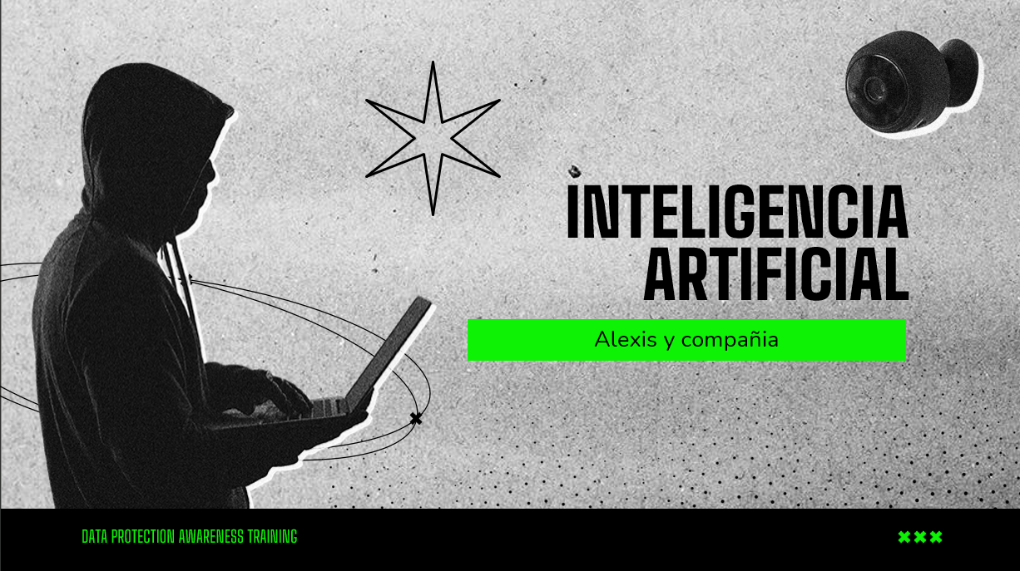
1. MAQUINAS REACTIVAS
Las máquinas reactivas basan sus decisiones y acciones en la situación existente, esto significa que no pueden utilizar experiencias pasadas para mejorar su proceso de toma de decisiones. En otras palabras, no pueden aprender.
DATA PROTECTION AWARENESS TRAINING

Slide 9
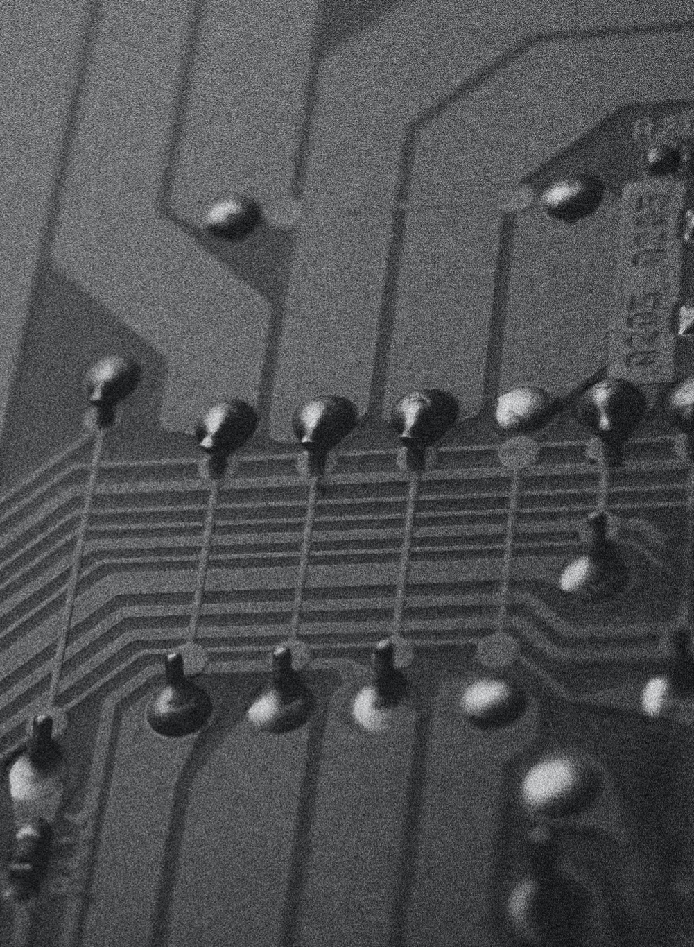
2. MEMORIA LIMITADA
Este es el tipo de IA que tenemos hoy, como vehículos autónomos, asistentes personales como Siri, chatbots, tecnología de reconocimiento facial, etc. En términos simples, las máquinas de memoria limitada están programadas para realizar tareas específicas, pero también son capaces de aprender.

Slide 10
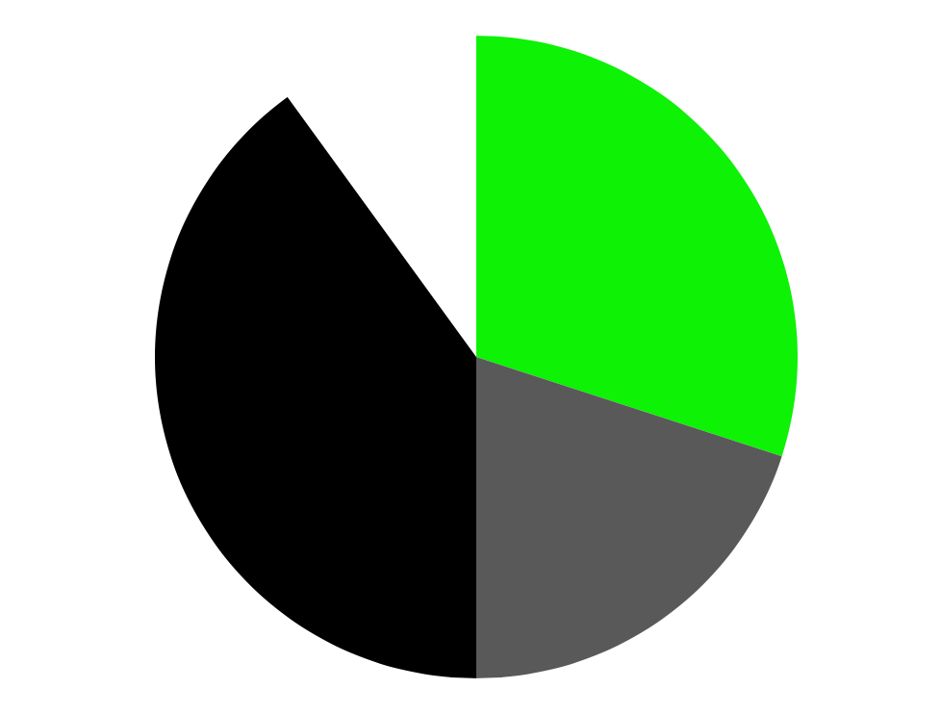
TEORIA DE LA MENTE
Con la teoría de la inteligencia artificial de la mente estamos de vuelta en el reino de lo hipotético. Implica desarrollar máquinas que puedan comprender emociones, deseos, necesidades y creencias. Piense en esto como una máquina con la que puede tener una interacción social de la misma manera que interactúa con otra persona.

Slide 11
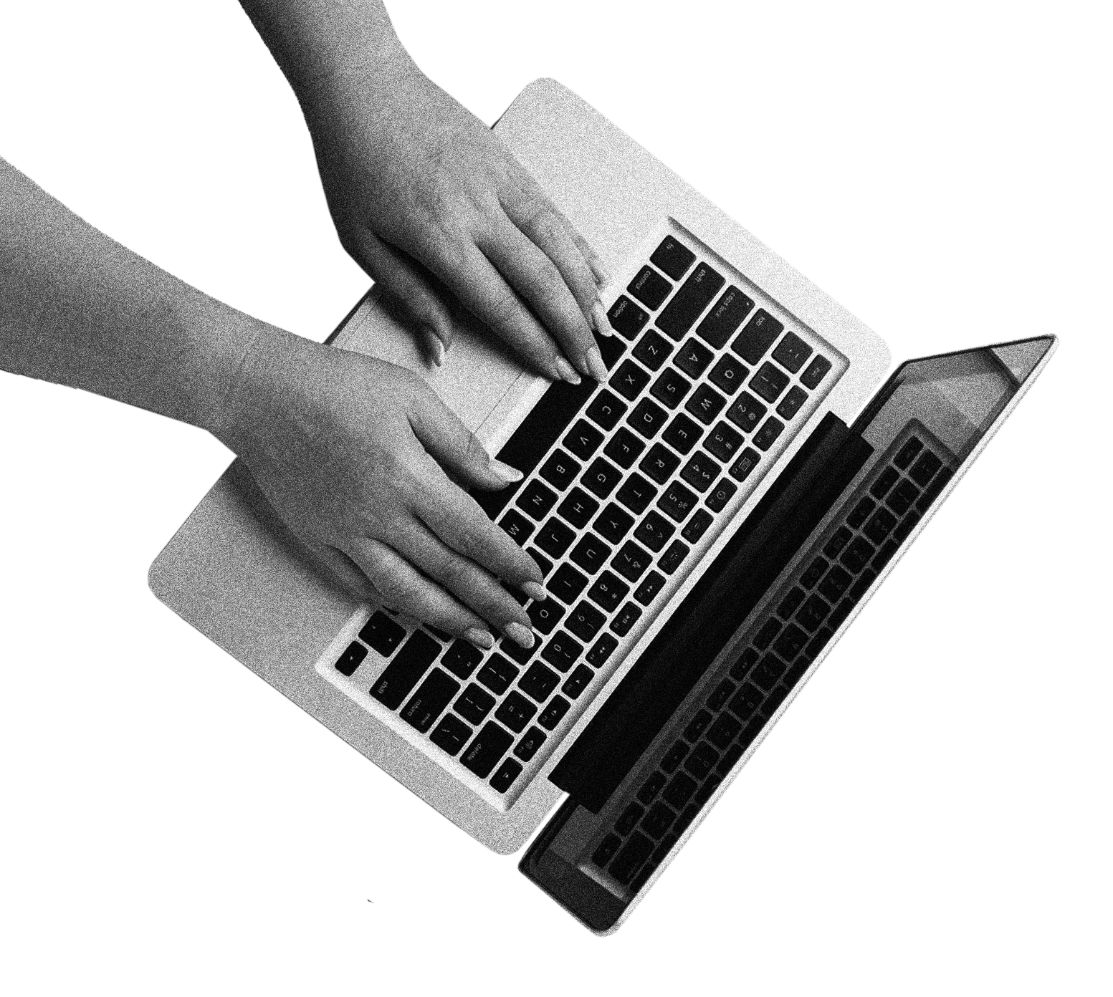
AUTOCONCIENCIA
La Inteligencia Artificial consciente de sí misma no solo comprende las emociones, necesidades y creencias humanas, sino que también tendrá emociones, deseos, necesidades y creencias propias.

Slide 12
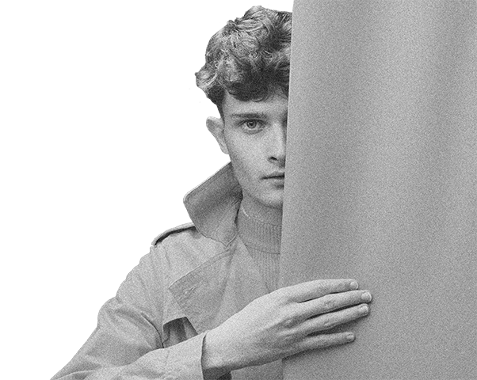
“This is a quote, words full of wisdom that someone important said and can make the reader get inspired.”
—SOMEONE FAMOUS
DATA PROTECTION AWARENESS TRAINING

Slide 13
CONCEPTS
CONCEPT 1
Mercury is the closest planet to the Sun and the smallest one in the Solar System—it’s only a bit larger than the Moon
CONCEPT 2
Venus has a beautiful name and is the second planet from the Sun. It’s hot and has a poisonous atmosphere

Slide 14
WHAT IS THIS TOPIC ABOUT?
MERCURY
MARS
VENUS
It’s the closest planet to the Sun and the smallest one in the Solar System
Despite being red, Mars is actually a cold place. It’s full of iron oxide dust
Venus has a beautiful name and is the second planet from the Sun

Slide 15
EXAMPLES
EARTH
Earth is the planet where we all live
JUPITER
Jupiter doesn’t have a solid surface
SATURN
Saturn is not the only planet with rings

Slide 16
OUR DISTRIBUTION PARTNERS
MARS
VENUS
NEPTUNE
Mars is actually a very cold place
Venus is the second planet from the Sun
Neptune is the farthest planet from the Sun
MERCURY
SATURN
JUPITER
It’s the closest planet to the Sun
Saturn is a gas giant with several rings
Jupiter is the biggest planet of them all

Slide 17
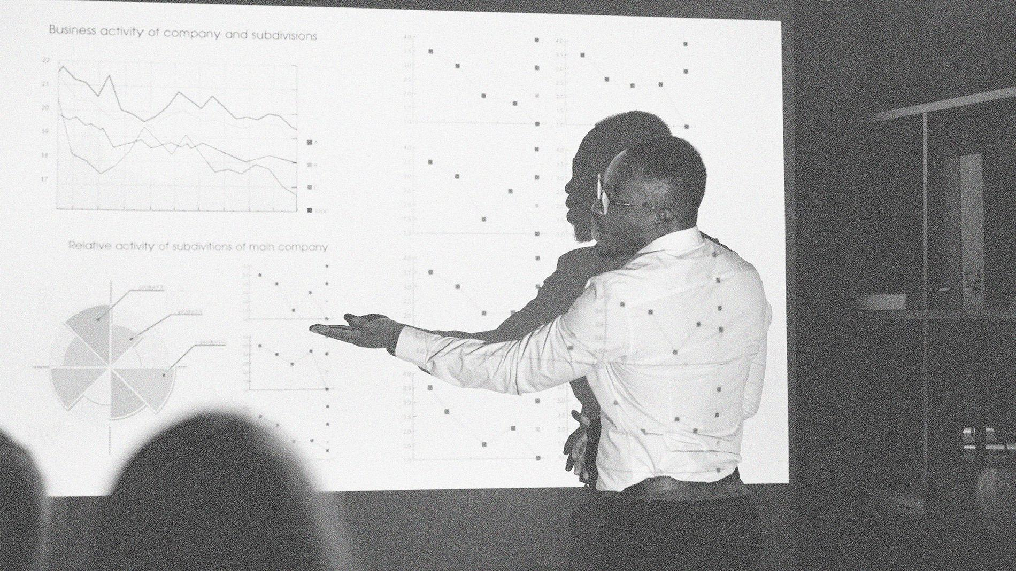
A PICTURE IS WORTH A THOUSAND WORDS
DATA PROTECTION AWARENESS TRAINING

Slide 18
498,000,000
Big numbers catch your audience’s attention
DATA PROTECTION AWARENESS TRAINING

Slide 19

SOME PERCENTAGES
25%
50%
90%
MERCURY
VENUS
MARS
It’s the closest planet to the Sun and the smallest one in the Solar System
Venus has a beautiful name and is the second planet from the Sun
Despite being red, Mars is actually a cold place. It’s full of iron oxide dust

Slide 20
THIS IS A MAP
NEPTUNE
Neptune is an ice giant
SATURN
Saturn is a gas giant
JUPITER
Jupiter is big

Slide 21
01
PRACTICAL EXERCISES
02
03
SATURN
Saturn is a gas giant with several rings
VENUS
Mercury is the closest planet to the Sun and the smallest one of them all
Venus is the second planet from the Sun
JUPITER
Jupiter is the biggest planet of them all

Slide 22
BRAINSTORM AND IDEA GENERATION
POWER 1
POWER 2
POWER 2
POWER 3
POWER 3
POWER 3
POWER 3

Slide 23
TOPIC MAIN IDEA AND DETAILS
MERCURY
MARS
VENUS
Mercury is the closest planet to the Sun
Mars is full of iron oxide dust
Venus has extremely high temperatures

Slide 24
SEQUENCE
VENUS
NEPTUNE
Venus is the second planet from the Sun
Neptune is the farthest planet from the Sun
MERCURY
SATURN
It’s the closest planet to the Sun
Saturn is a gas giant with several rings

Slide 25
CLASSIFYING
MARS | VENUS | MERCURY | JUPITER
Small Red Cold Rocky | Small Hot Dry Volcanic | Small Hot Rocky Cratered | Large Cold Gassy Stripped
Mars is actually a very cold place | Venus is the second planet from the Sun | It’s the closest planet to the Sun | Jupiter is the biggest planet of them all

Slide 26
CAUSE AND EFFECT
PROBLEM OR GOAL
SATURN
VENUS
Saturn is a gas giant with several rings
Venus is the second planet from the Sun
MARS
JUPITER
Mars is actually a cold place
Jupiter is the biggest planet of them all

Slide 27
QUESTION AND ANSWER
QUESTION
ANSWER
Despite being red, Mars is actually a cold place. It's full of iron oxide dust, which gives the planet its reddish cast
Jupiter is a gas giant and the biggest planet in the Solar System. It's the fourth-brightest object in the night sky

Slide 28
TIMELINE
It’s the closest planet to the Sun
Jupiter is the biggest planet of them all
MERCURY
JUPITER
VENUS
SATURN
Venus is the second planet from the Sun
Saturn is a gas giant with several rings

Slide 29

PARTS AND WHOLE
THE WHOLE OBJECT
PARTS OF THE OBJECT
Earth is the third planet from the Sun and the only one that harbors life in the Solar System. This is where we all live
Ceres is in an asteroid belt
MARS
VENUS
IF THE PARTS WERE MISSING
WHAT IS THE FUNCTION?
Venus is the second planet from the Sun
Pluto is now considered a dwarf planet

Slide 30
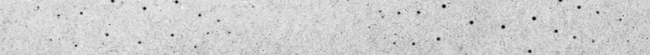
¡GRACIAS!
ALEXIS DELGADO
DAMY VILLEGAS
SHARIK LLANTA
SAMUEL DOMINGUEZ
DATA PROTECTION AWARENESS TRAINING

Slide 31
ALTERNATIVE RESOURCES
PHOTOS
Black man giving presentation on a meeting
Man working with a computer
Woman reading on the monitor
Flat design data privacy template
Flat design data privacy template 1
VECTORS
Flat sparkling star collection

Slide 32
RESOURCES
PHOTOS
Flat design data privacy template
Flat design data privacy template 1
Flat design data privacy template 2
Flat design data privacy template 3
Flat design data privacy template 4
Circuit board close-up with different connections
Black man giving presentation on a meeting
VECTORS
Flat device mock-up infographic
New gdpr concept with infographic design

